Slide 1

LAB SQL 03 Database(s): salesshort Lab goals. Use the GROUP BY, HAVING clauses and other aggregate functions with either your local MySQL Community Server instance or the on-premise MySQL server at Leeds. If you use your local MySQL Community Server instance, you will need to load the salesshort database into your local instance using the .sql file: DB02 salesshort.sql. Remember to select ‘Don’t Limit’ to ensure your query results are not being limited to the first 10, 50, 100 rows, etc…
If you are still troubleshooting any part of the MySQL installation process and/or connection to the MySQL server instance at Leeds, please reference this PowerPoint. You can also use MySQL in phpMyAdmin as a demo.
MSBX-5405
Originally created by: Dr. Karina Hauser
Modified by: Keith Sparling

Slide 2
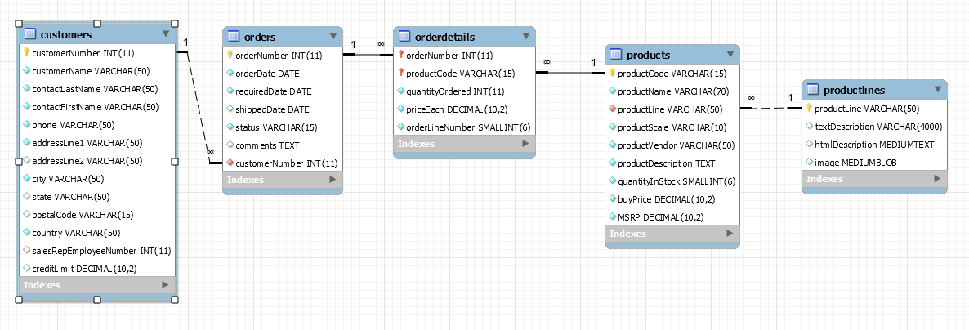
ER Diagram for SalesShort Database

Slide 3
LAB SQL 03 Save a .sql script labeled: lab03_”your IdentiKey” (for example: lab03_kesp5555)
Aggregate Functions
Write SQL SELECT statements to answer the following…
How many customers are in the customers table?
How many German customers are in the customers table (i.e., from ‘Germany’)?
How many customers does the customers table have from each country? Order by most to least customers.
What is the average MSRP across all products in the products table?
What is the total revenue of the company using the orderdetails table? For ‘total revenue,’ we will use the formula sum(quantityOrdered * priceEach).

Slide 4
LAB SQL 03 Save a .sql script labeled: lab03_”your IdentiKey” (for example: lab03_kesp5555)
GROUP BY/HAVING
Write SQL SELECT statements to answer the following…
How many products (i.e., productName) does each productline have? Order by most to least.
How many products does each productline have? Show only the productline(s) with 10 or more products. Order by most to least.
Show the ‘total revenue’ (i.e., sum (quantityOrdered * priceEach)) for each orderNumber. Order by highest to lowest revenue.
How many orders have been cancelled (i.e., status = ‘cancelled’)?
Show the total ‘quantity in stock value’ (i.e., sum(quantityInStock * buyPrice)) by productVendor. Order by highest to lowest ‘quantity in stock value.’

Slide 5
LAB SQL 03 Save a .sql script labeled: lab03_”your IdentiKey” (for example: lab03_kesp5555)
How many customers from the customers table have no sales representative(s)?
Show the ‘total revenue’ by productCode. Show only products with more than 50,000 in ‘total revenue.’ Order by highest to lowest revenue.
How many customers does the company have in each country/city (i.e., group by country, then by city) with a creditLimit over 100,000? Order by most to least customers while showing only cities with 2 or more customers.
How many customers does each sales representative (i.e., salesRepEmployeeNumber) have in each city? Remove/exclude any rows where the salesRepEmployeeNumber is NULL. Order by the number of customers (i.e., count of customers) in descending order.
Show the number of products for each productScale. Order by productScale in ascending order.

Slide 6
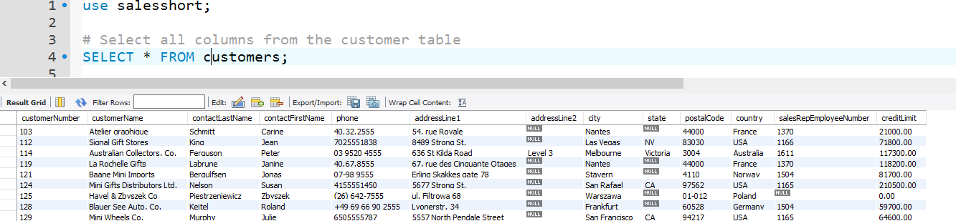
Submit the following:
One .sql file with your 15 SQL scripts.
OPTIONAL…a word document, PDF, or PowerPoint with screenshots of your SQL code and the first 10 - 20 lines of output for each of your 15 SQL scripts (i.e., select statements). Example:
This lab assignment will be reviewed by two peers, taking the average score from these two peer reviews, based on (1) the ability to execute/run each select statement and (2) the “recommended” output for each select statement.

